Slide 1
President’s Welcome

Slide 2
Welcome!

Slide 3
The SCT is an international, multidisciplinary, scientific, and educational organization dedicated to enhancing the excellence and value of clinical trials.
It relies on volunteers and community engagement.
Thank you!

Slide 4
Examples of New Initiatives
Early Career Special Interest Group
Academic Data Coordinating Centers Special Interest Group
Communication strategies
  Launching the new SCT LinkedIn Company Page (https://www.linkedin.com/company/society-for-clinical-trials/)
  Social Media Ambassadors
  Newsletter enhancements with historical and educational content

Slide 5
Clinical trials are the most important medical invention in history.
They are without equal, providing the most robust and reliable information regarding the benefits and harms of interventions for treating and preventing human disease.

Slide 6
We share a duty to:
(i) protect the ideals and principles that make clinical trials the evidence pinnacle,
(ii) remind the world of their unparalleled value to human health, and
(iii) educate the community on their design, conduct, analyses, and reporting.
This week we collectively celebrate clinical trials!

Slide 7
“Shaping the Future:
The Right Questions, Robust Answers”.
Identifying the most important questions for clinical practice and finding robust answers to those questions, is the heart and soul of clinical trials.

Slide 8
Clinical trials are scientific instruments, objectively assessing whether effects exists rather than seeking to establish that they do.
Successful trials address important questions and obtain robust answers to those questions regardless of the directionality and magnitude of the effects.
It is paramount to preserve the evidentiary and integrity standards that provide clinical trials with the most reliable evidence for informing care.

Slide 9
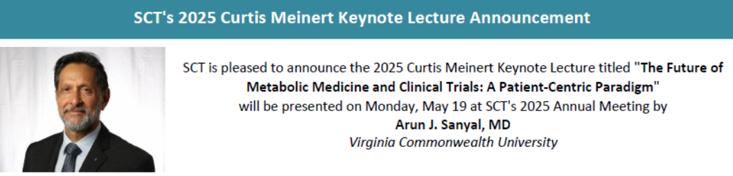
Improving the lives of humankind through informed decision-making is the goal of the clinical trial community.
Focusing on pragmatic questions to match their clinical importance, and tailoring approaches to address them, advances this cause.
Pragmatism requires a patient-centric approach.
“The good physician treats the disease; the great physician treats the patient who has the disease.”
Canadian physician Sir William Osler

Slide 10
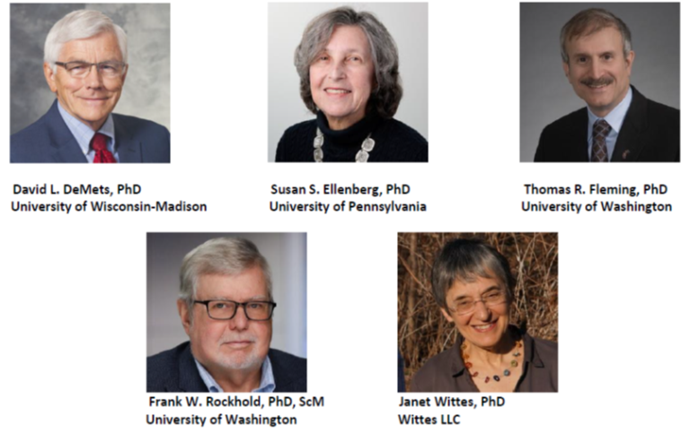
Improvement to DSMB practices is a necessity.
Needed are appropriate training and education.
The Founders Lecture

Slide 11
We express appreciation and support for our colleagues and their associated health institutes in the United States.
We acknowledge and celebrate their important contributions to clinical trials and to the clinical trial community.
No investment pays greater dividends to humankind than the highest quality health research through clinical trials.

Slide 12
We thank our Canadian hosts, our European friends, and a large contingency from Japan for their commitment and support during this time when the US attendance been impacted.

Slide 13
We will be resilient and persistent,
and stick together and support each other.
It is our desire and our duty to remain focused on the important work that we do to advance science for the betterment of human health and society.

Slide 14
A community leader was asked
“How are people coping?”
His answer was inspiring and motivating:
“Kapwa”.

Slide 15
In many cultures around the world, there are ingrained philosophies and practices that emphasize the importance of
respect, compassion, and solidarity, and
promote of a sense of collective responsibility and shared humanity.
In African communities there is the philosophy of Ubuntu,
meaning “humanity to others”
and often described as
“'I am what I am because of who we all are”.

Slide 16

In Japan, there is the culture of Wa, where people prefer a harmonious community of peaceful social unity for the collective good, over individual interests, creating a sense of sense of shared belonging.

Slide 17
The world could use a dose of a Kapwa / Ubuntu / Wa cocktail.
This week we have been collectively assigned a high dose.

Slide 18
In that spirit,
I am pleased to announce,
regarding the exchange of knowledge in clinical trials,
between the United States, Canada, and all other world nations,
a permanent removal of all tariffs,
effective immediately.

